Slide 1



EcoEnergy Corp: Global Sustainable Infrastructure
& Technology
This presentation reviews our performance, focusing on key regional challenges and strategic opportunities for margin improvement.

Slide 2






Meet The Global Leadership Team
Niall Grainger
Martinas Jucys-Brady
Daniel Vala
Lead Analyst, North America
Lead Analyst, South America
Lead Analyst, Africa
Roisin Murphy
Aleksander Lupa
Lead Analyst, Europe
Lead Analyst, Asia

Slide 3
Agenda
Profitability
Regional Analysis
Our Solution

Slide 4
Profitability
1.

Slide 5
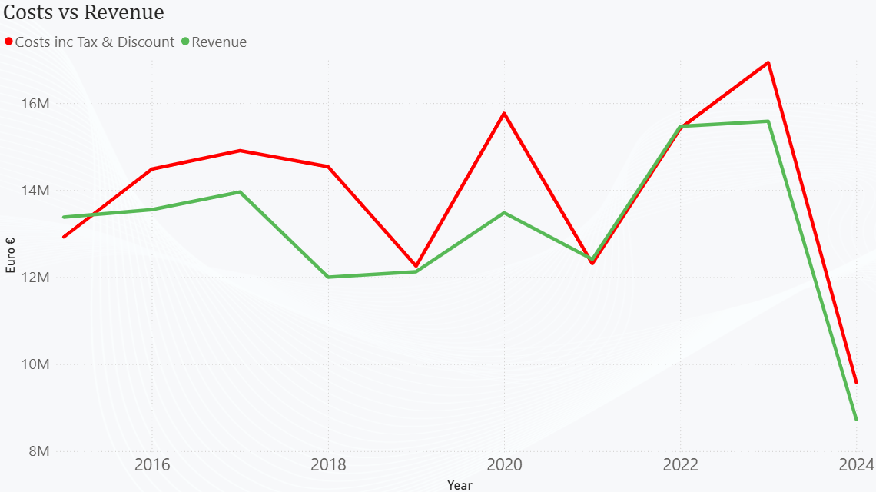
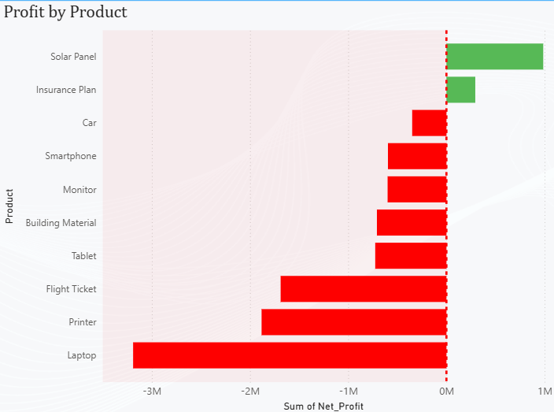
Profit Crisis
Revenue vs. Costs
Portfolio Risk
Bright Spots
€130.7M revenue
39% of products sold at a loss
Insurance plans and solar panels
€139.1M costs
8 of 10 products were unprofitable
Foundation exists for turnaround
€8.46M net loss

Slide 6
Regional Analysis
2.

Slide 7
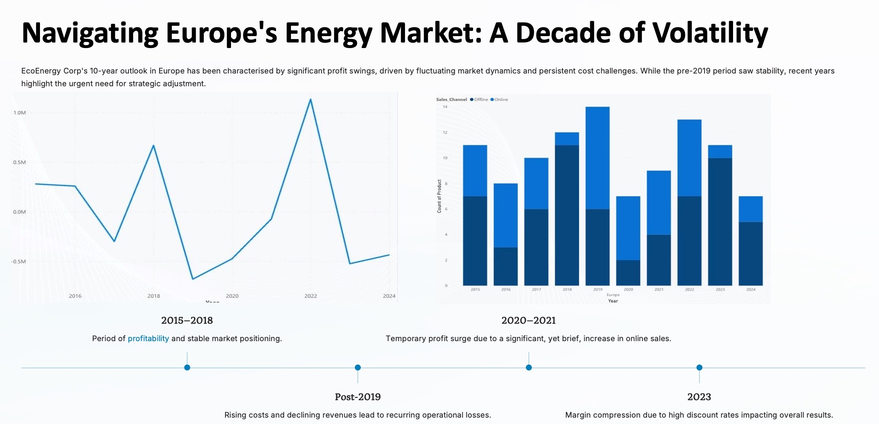

Slide 8
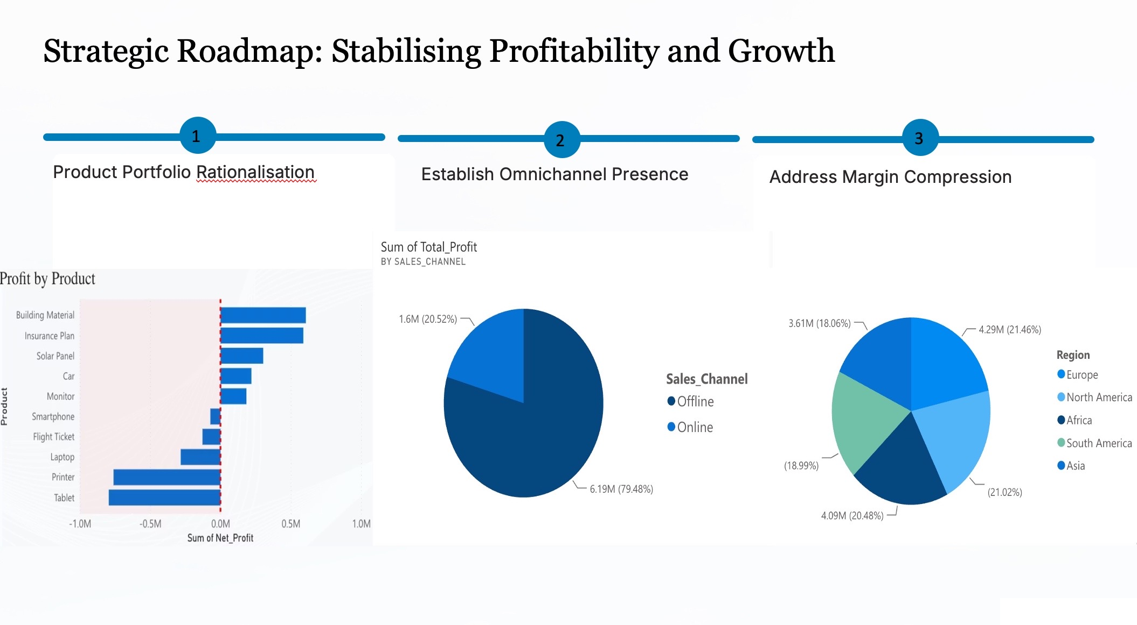

Slide 9
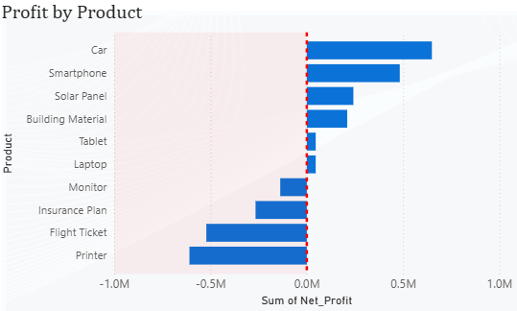
Asia Financial Overview: Revenue vs Profit Gap
€24.05M
Total Revenue (10 years)
High revenue generation across the Asian market, reflecting strong market presence and sales volume.
€0.14M
Net Profit (10 years)
Minimal net profit indicates severe margin erosion despite significant revenue figures.

Slide 10
Asia: Profitable vs Loss-Making Periods
2015-2017
1
Profitable years driven by cars, solar panels
and early technology products, with relatively disciplined portfolio and channel management.
2
2018-2023
Sustained loss-making period caused by aggressive discounting and the persistence of loss-making products (flight tickets, insurance, printers, some tech devices).
2024
3
Return to profit, reflecting a tighter technology-focused portfolio, better margin control and a more balanced online/offline mix.

Slide 11
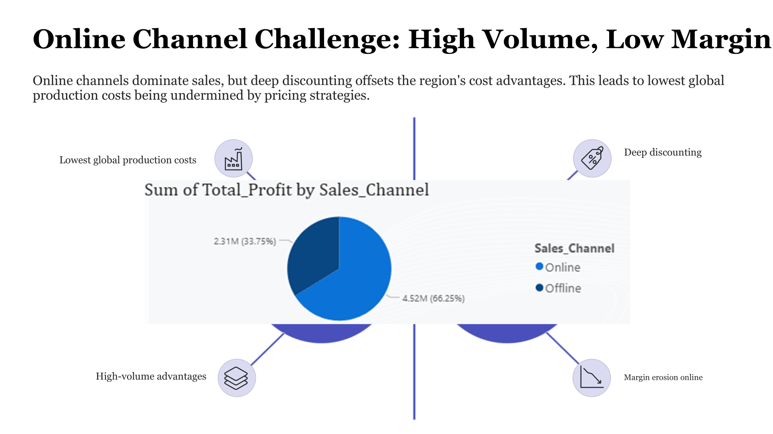
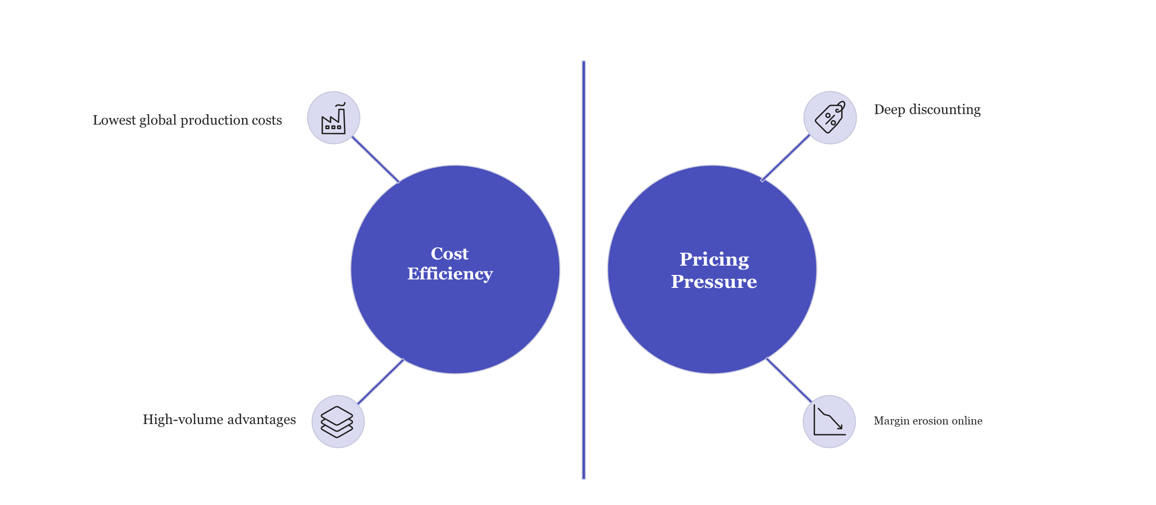
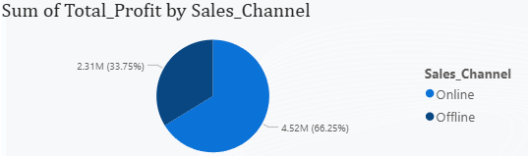

Online Channel Challenge: High Volume, Low Margin
Asia’s Total Profit by Sales Channel

Slide 12
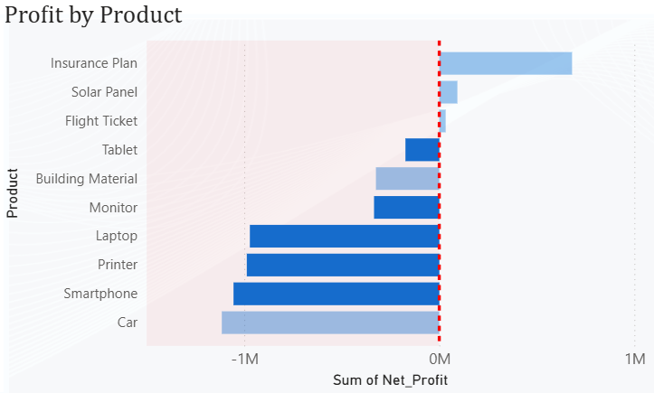
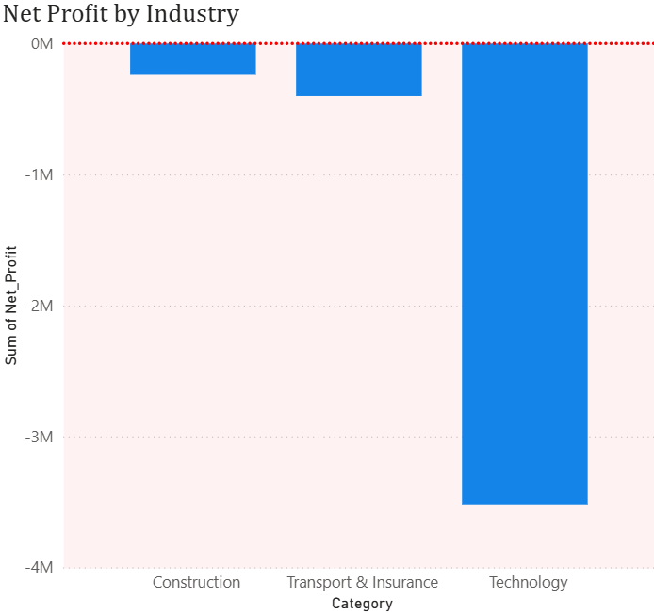
North America: Significant Profitability Erosion
Widespread Unprofitability
Substantial Financial Losses
7 out of 10 products are currently posting negative net profits, indicating a systemic issue.
Total losses for the region amount to €4.15 million, driven by underperforming product lines.
Key Sector Underperformance
Technology, Transport, and Insurance sectors show significant negative margins, impacting overall regional profitability.

Slide 13
Pricing Problems
Below-Cost Sales & Heavy Discounting
Heavy Discounting
An average discount rate of 16% across all products severely impacts gross margins, undermining efforts to achieve profitability.
Below-Cost Sales
Several key product lines are consistently sold below their production cost, leading to guaranteed losses:
Printers
Cars
Smartphones
Laptops

Slide 14
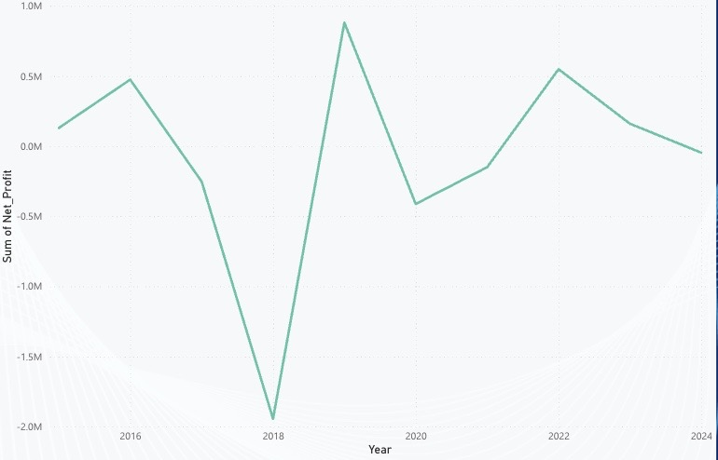
South America Financial Overview
€25.35M
€25.95M
- €607.54K
Total Revenue (10 years)
Total Costs (10 years)
Net Loss (10 years)

Slide 15
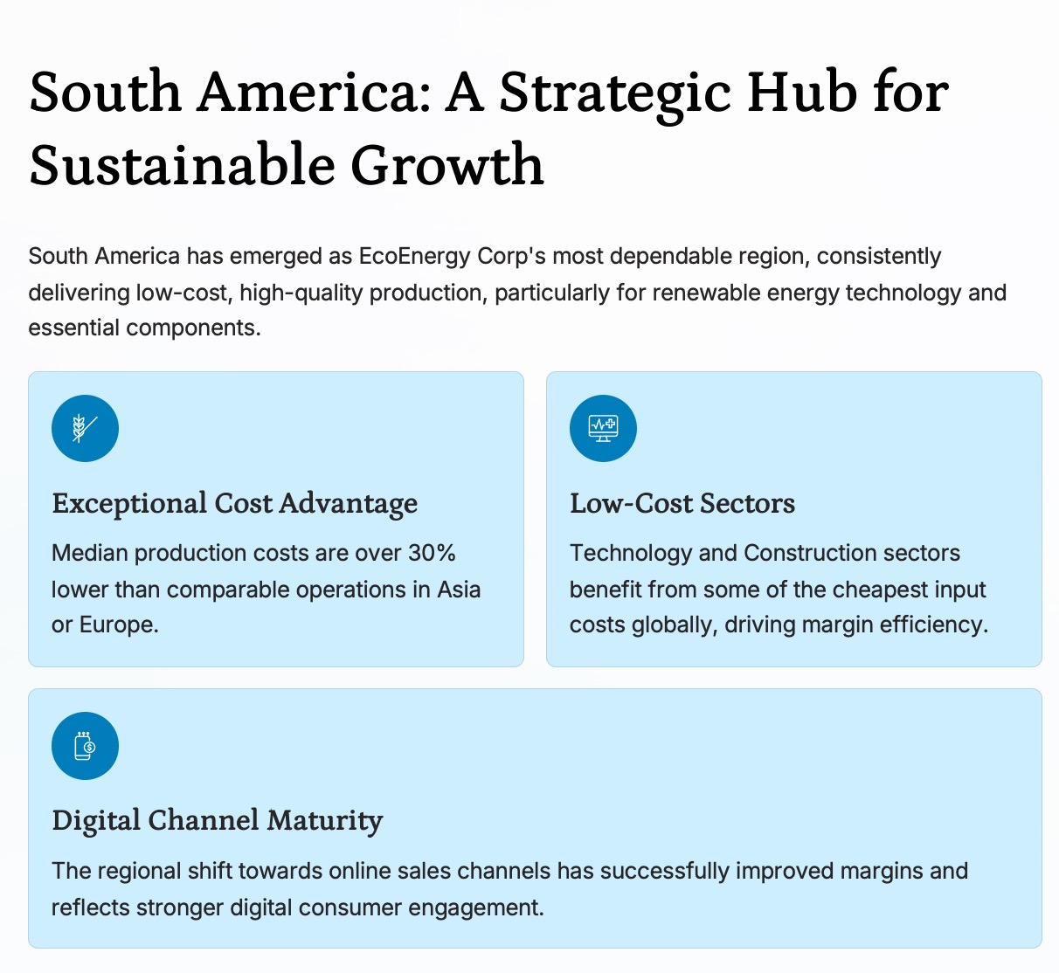
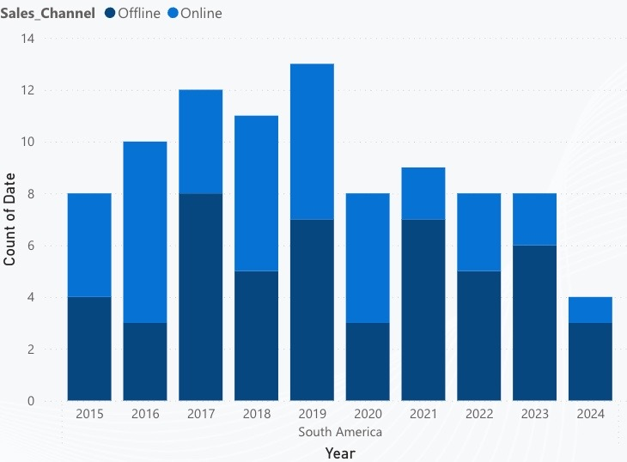

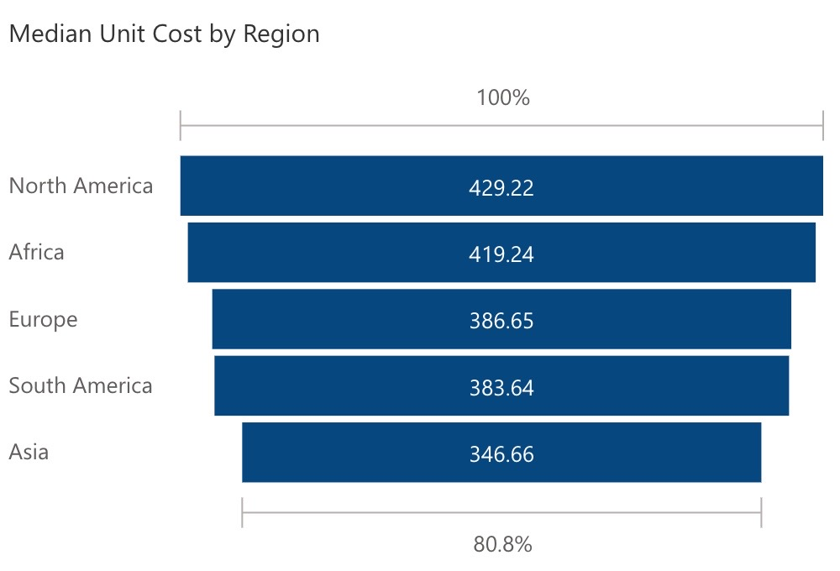
Sales_Channel Offline Online

Slide 16
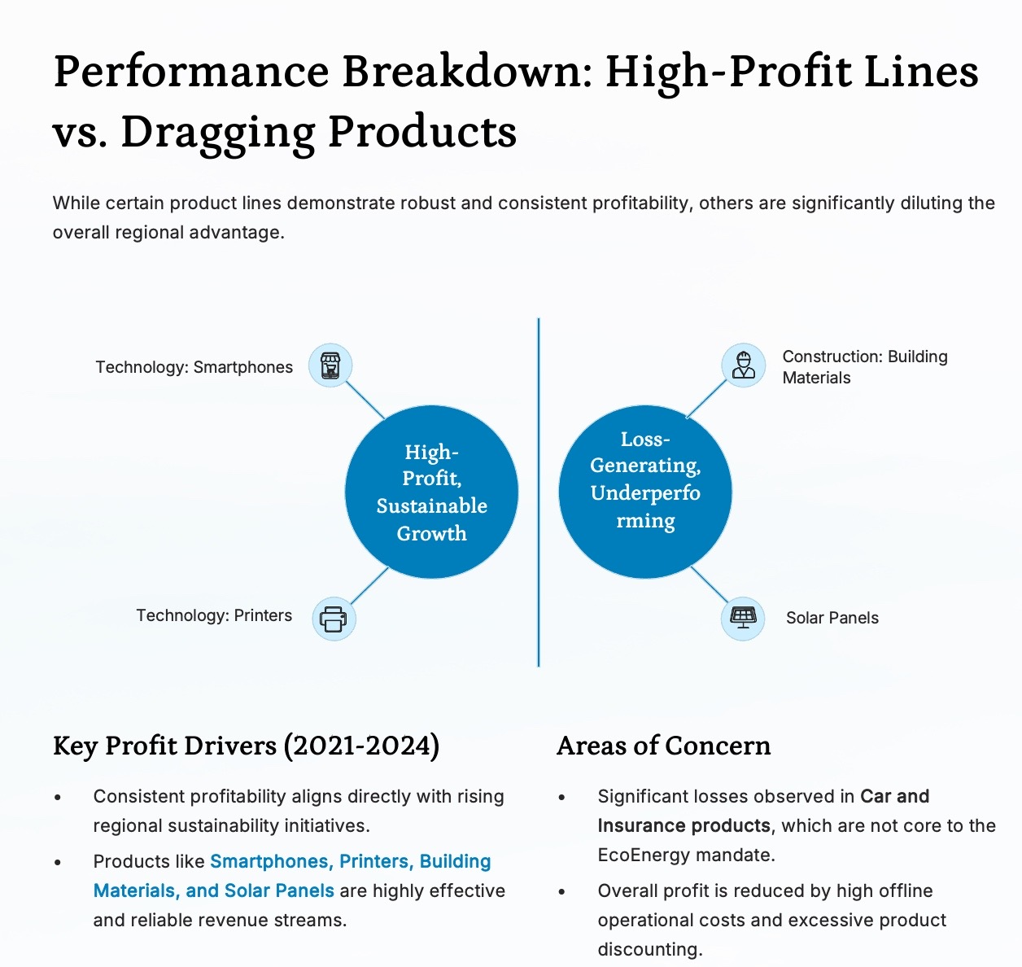

Cars
Insurance

Slide 17
Africa Financial Overview: Revenue vs Profit Gap
€25.17M
- €3.7M
Total Revenue (10 years)
Net Loss (10 years)
High accumulated loss shows alarming need for change in company's activities in African market

Slide 18
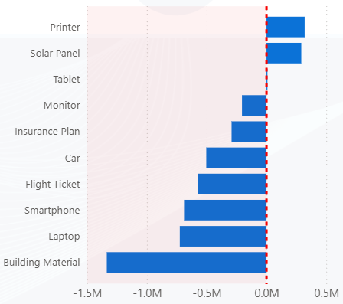
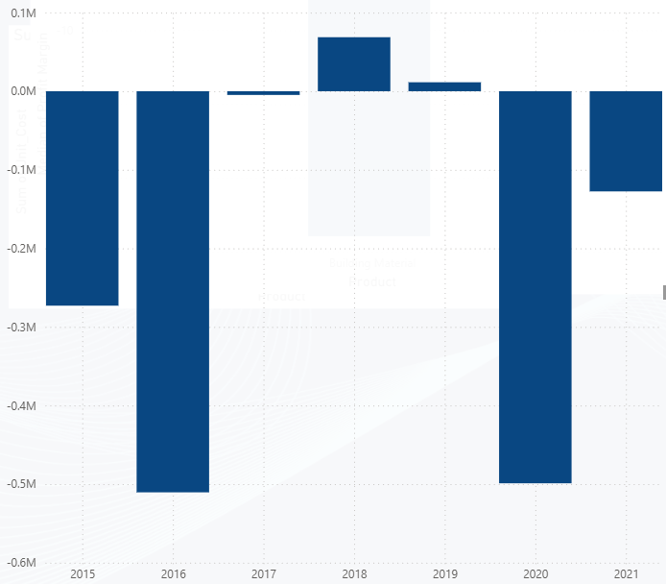
Africa - Product Performance
The only profitable products are Printers and Solar Panels, which have turned profitable only in recent years
Building materials have been consistently unprofitable over the past 7 years

Slide 19
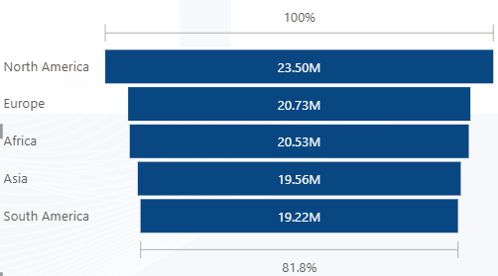
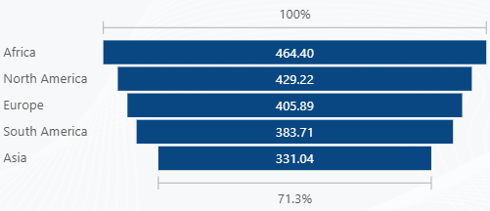
Africa's main loss driver: High costs
A comparison of unit costs in the Technology and Transport & Insurance sectors shows that Africa is the costliest region
Sales are around the average compared to other regions

Slide 20
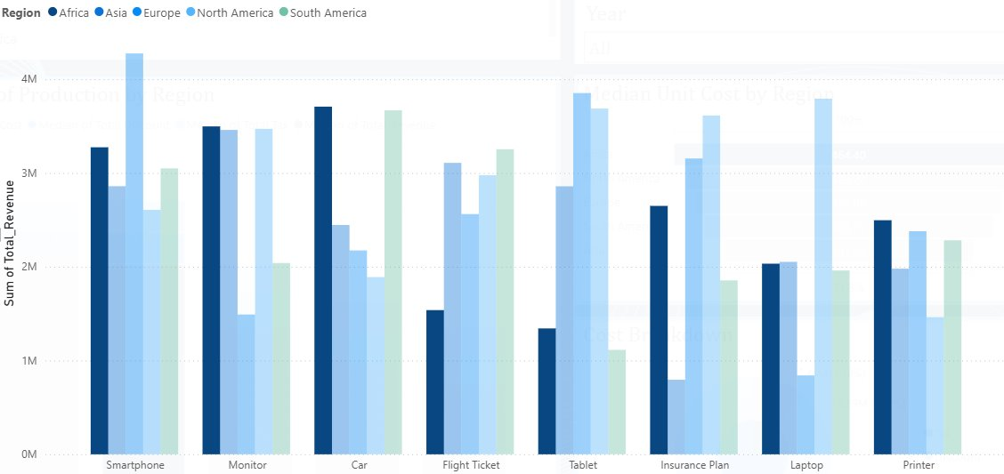
Smartphones, Monitors, and Cars have high sales compared to other regions – showing strong potential if costs are managed better

Slide 21
Looking Forward

Slide 22
Our Solution
3.

Slide 23



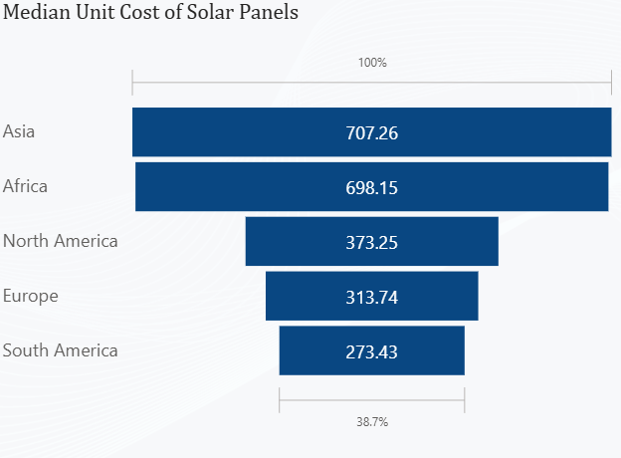
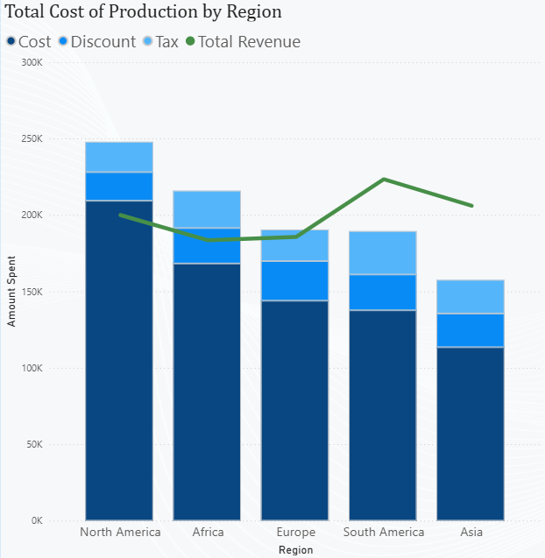
Outsourcing Production
Cost Breakdown
Industry Specialists
Global Production Hubs

Slide 24
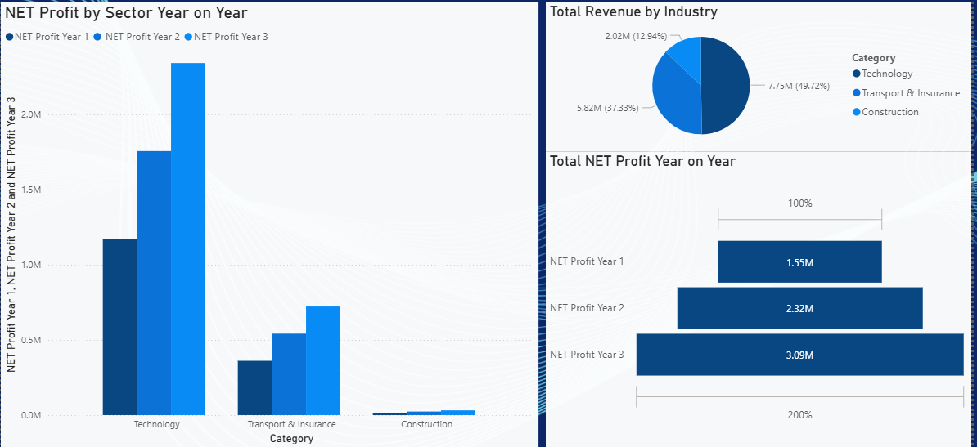
Predictive Analysis: 3 Year Forecast

Slide 25

Green Identity in Global Expansion
Supplier Audits
Renewable Energy
Strict environmental controls across all operations
100% renewable power for manufacturing
Transparency
Regular emissions progress reporting

Slide 26
Thank You for Listening

